Slide 1

Weather here

Slide 2
INDEX
About Us
Our Team
Project Summary
Project Scope
Tools and Technologies
Data Model
Data Storage
The Application Code
Visualizations
Website Frontend Design
Website Deployment
Web API
Gap Analysis
Live Demonstration

Slide 3
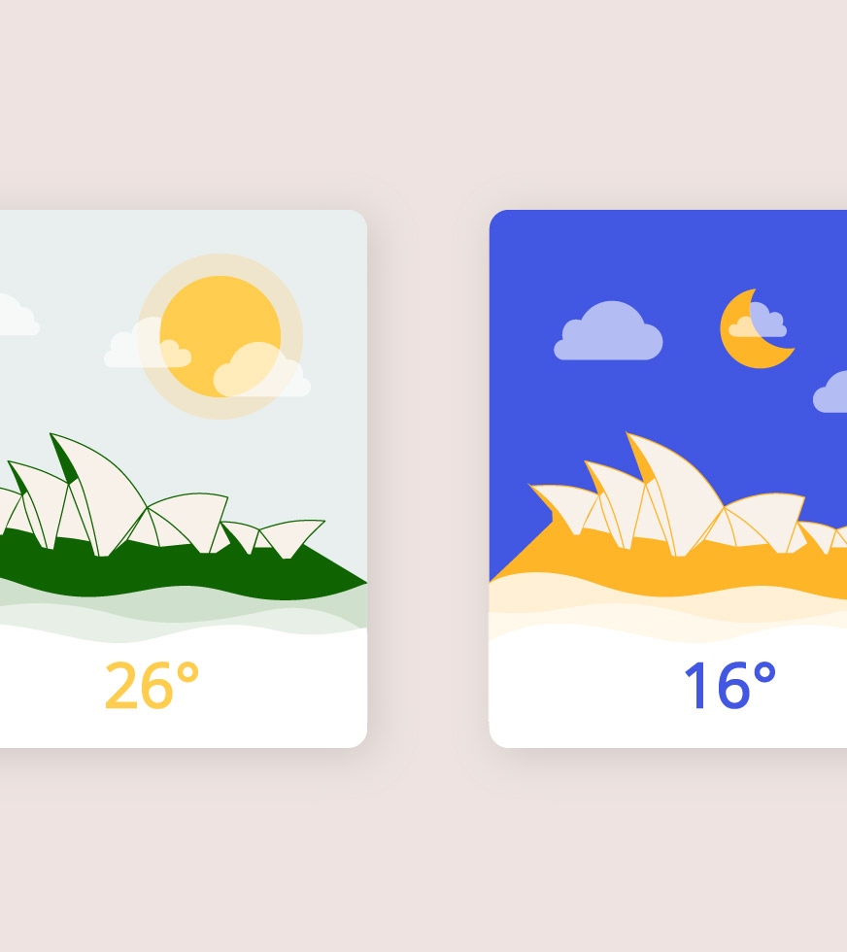
ABOUT US
SOFTWARE SOLUTIONS COMPANY
We provide high-end solutions to our renowned clients worldwide.
Customize the solutions such that it is useful to the end user and innovative enough as well
Connect and expand with clients across multiple domains.

Slide 4


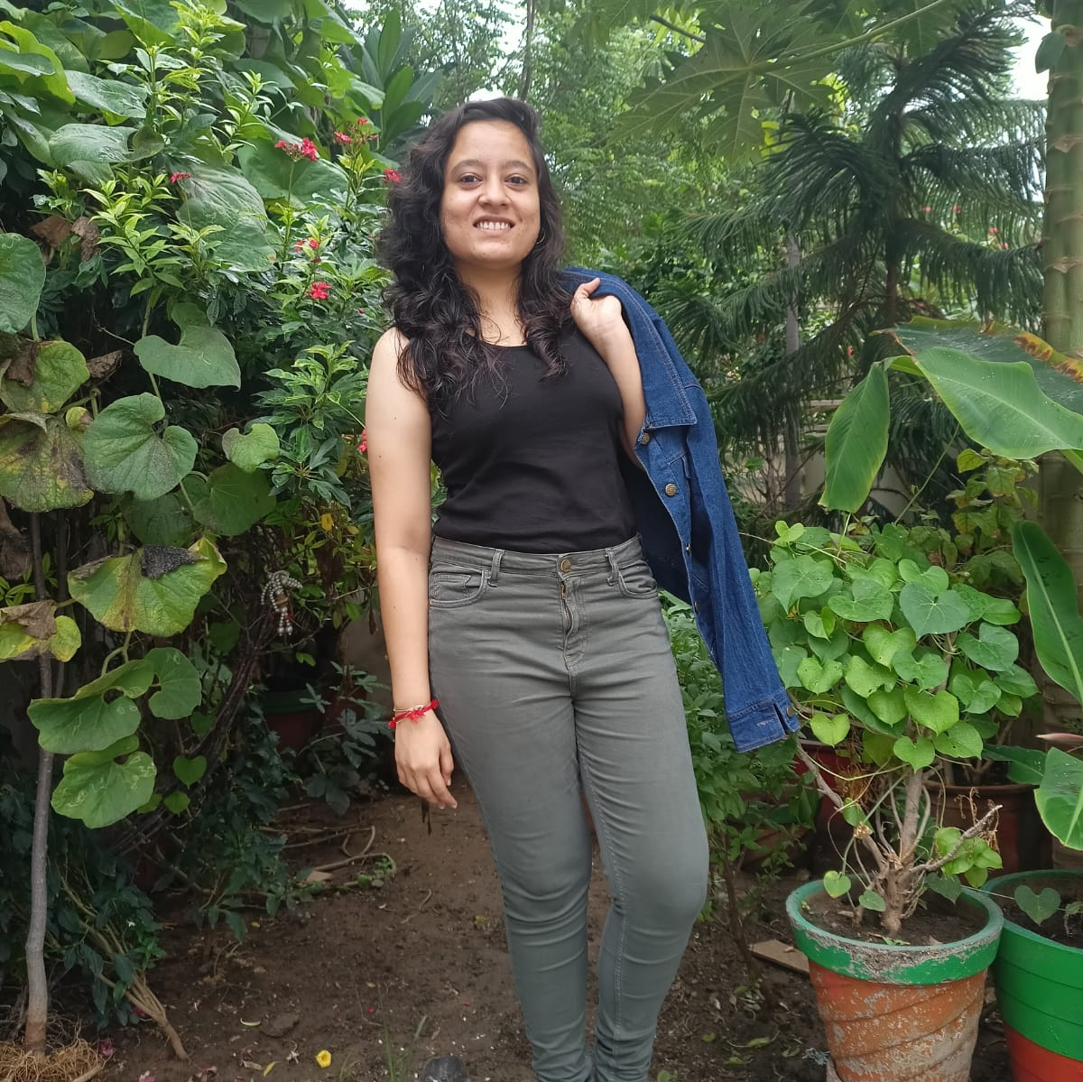
OUR TEAM
Bhavi Sureshkumar Dudhat
Neev
Priya Chuahan
Web Developer & Business Analyst
Bachelor in Computer Engineering
Project Manager
Data Analyst

Slide 5
The web application first extracts the user’s public IP address, then get the geolocation from IP address, as per the longitude and latitude details of geolocation the Weather API sends local weather details as a response.
This data is then sent to MongoDB(Cloud storage) and also displayed on the Weather dashboard webpage.
Also, configured stand-alone APIs that serves data from the live cloud database to Get all items, Get a range of items and Get item by ID.
PROJECT SUMMARY
Real –Time Weather Application
The web application - W.here tracks user’s public IP address to provide the real-time weather dashboard.
5

Slide 6
PROJECT SCOPE
1. Extract Geolocation based
On Public IP Tracking
Passing the public IP address extracted from request headers to the IP function of geocoder python library gives the local longitude and latitude information
2. Get the local weather data
from API
Passing the geolocation parameters from step 1 to the fcc weather API, gives all weather related information as a response in a JSON format.
3. Stored the data
in MongoDB
The API data is stored in MongoDB cloud.
4. Develop the Flask
application and visualizations
Using python loading the data from API to the flask app and also used the data to design a visualization.
5. Deploy the Web App
Deployed the responsive web-app on Heroku so that anyone can access it using any device.
6. Live API
Created an API using MongoDB Realm to access data from cloud.
6
Weather Here

Slide 7






HTML
Flask
Markup language which is used to display the front-end alongwith CSS styling.
Flask is a python framework used in core web development of the project
TOOLS
&
TECHNOLOGIES
JavaScript
MongoDB & MongoRealm
Javascript is a lightweight programming language with first-class functions used to display data using google chart
Cloud storage and Live API building
GitHub
Heroku
Stored code on Github for hosting on Heroku
Cloud platform for web deployment

Slide 8
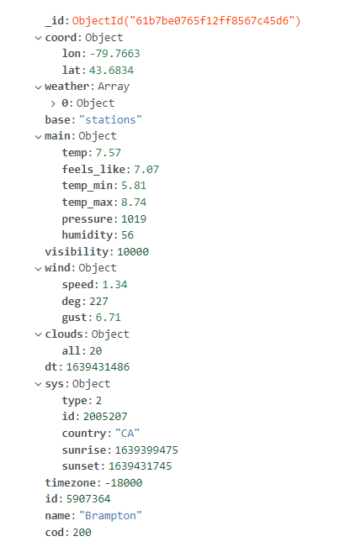
DATA MODEL
Weather Data
The API response sent to MongoDB storage is as shown in the image, it contains geolocation and weather related Data.
Weather Here

Slide 9
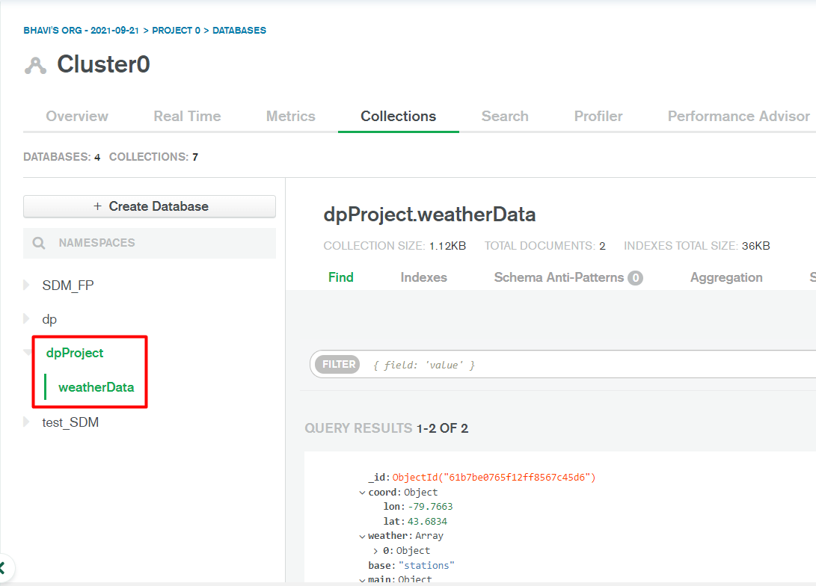

DATA STORAGE
MongoDB Cloud
Stored the data in weatherData
collection in the dpProject database
On MongoDB Atlas cloud.
34˚

Slide 10
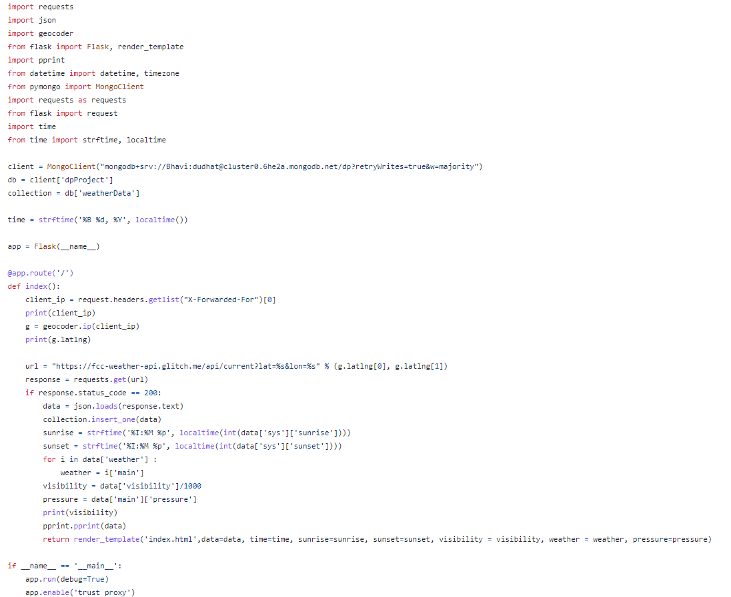

APP CODE
Python Web Application
Flask backend code for accessing geolocation
Data from request headers, passing to API and
Gathering respective Weather data as a
Response, displaying it on webpage and
sending to the mongoDB cloud.

Slide 11
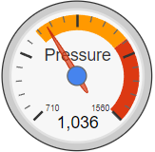
VISUALIZATION
Google Charts
Using the live Atmospheric pressure data received a s a Response from the API in googlecharts.js Gauge chart to visualize it as a Barometer

Slide 12
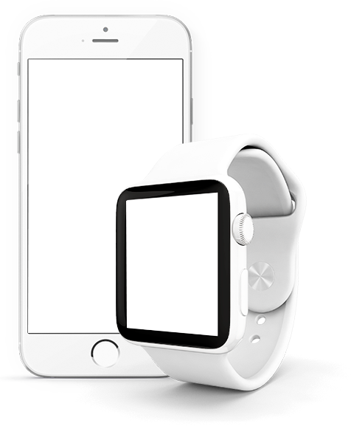
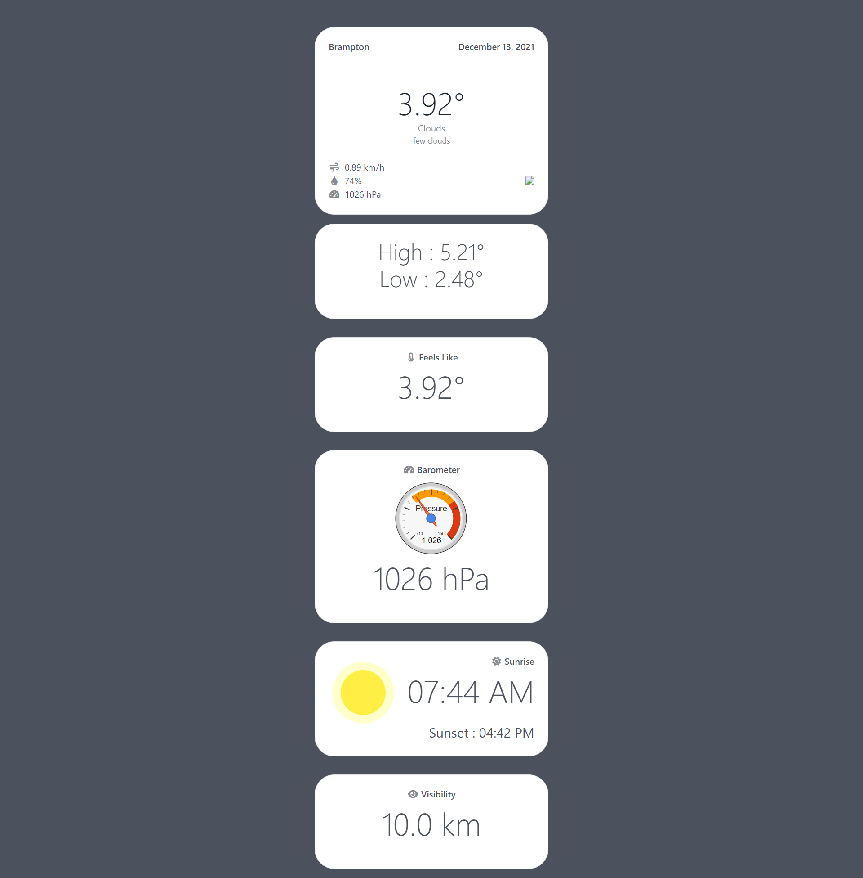
Used different cards for various parameters
WEBSITE FRONTEND DESIGN
Responsive layout using Bootstrap and CSS
Rich UI design to fulfill aesthetic demand

Slide 13

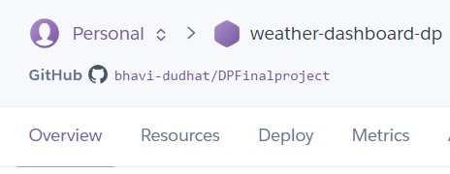
WEBSITE DEPLOYMENT
W.here
https://weather-dashboard-dp.herokuapp.com/

Slide 14
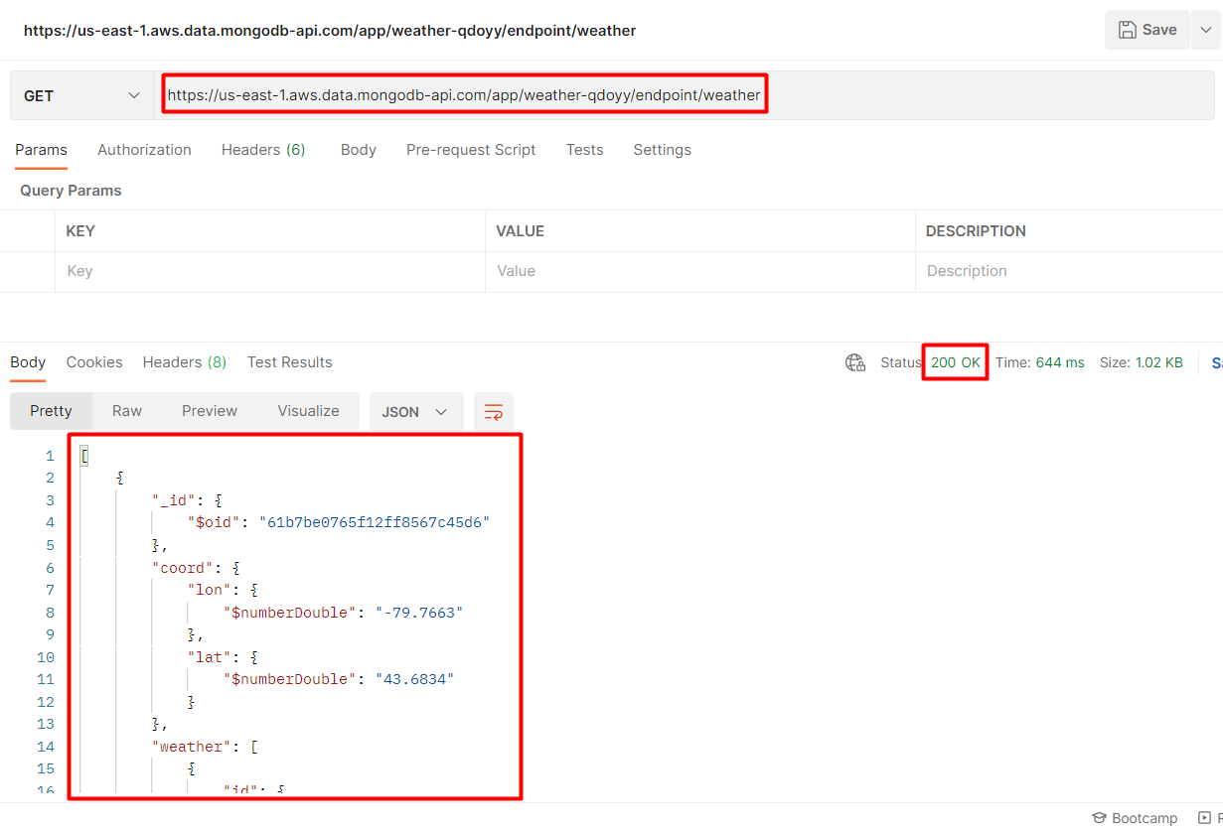
LIVE API Get all items
https://us-east-1.aws.data.mongodb-api.com/app/weather-qdoyy/endpoint/weather

Slide 15
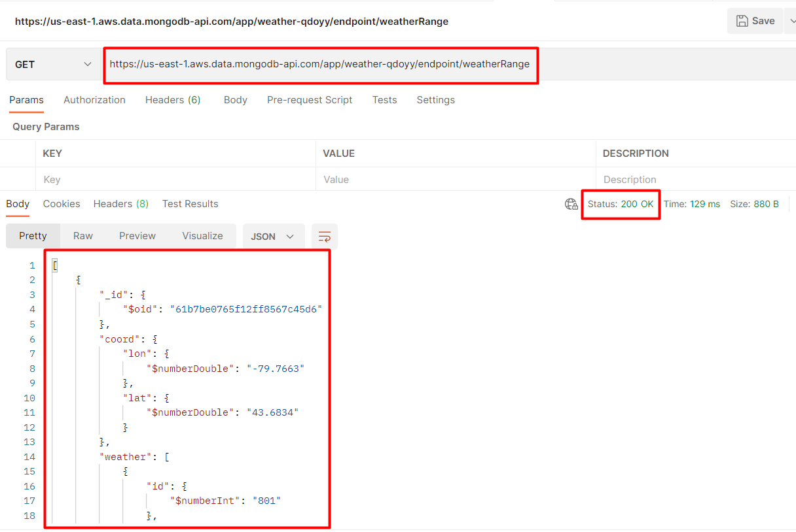
LIVE API Get a range of items
https://us-east-1.aws.data.mongodb-api.com/app/weather-qdoyy/endpoint/weatherRange

Slide 16
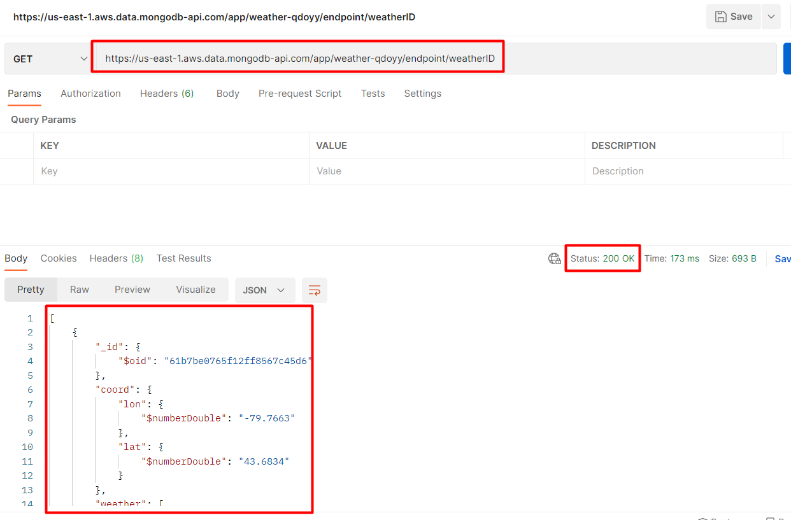
LIVE API Get item by ID
https://us-east-1.aws.data.mongodb-api.com/app/weather-qdoyy/endpoint/weatherID

Slide 17
FIT GAP ANALYSIS
Weather forecasting feature can be added
One card for any 4 cities weather as per user preferences
Default API response and other API limitations can be worked around
More Visualizations could be performed

Slide 18


LIVE DEMONSTRATION

Slide 19
GitHub Link :
https://github.com/bhavi-dudhat/DPFinalproject
YouTube Link :
https://www.youtube.com/watch?v=zbw9nL6vRSQ

Slide 20
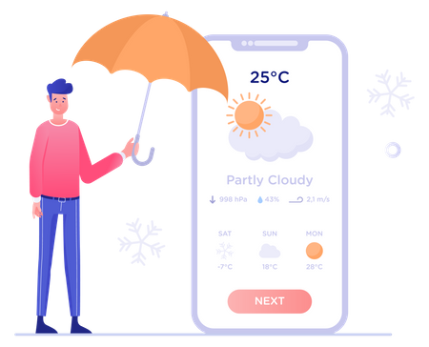
THANK
YOU

